Slide 1
Error handling in JavaScript

Slide 2
Error handling in JavaScript
JavaScript is a loosely-typed language.
It does not give compile-time errors.
So some times you will get a runtime error for accessing an undefined variable or calling undefined function etc.
JavaScript provides error-handling mechanism to catch runtime errors using try-catch-finally block, similar to other languages like Java or C#.

Slide 3
Error handling in JavaScript
try
{
// code that may throw an error
}
catch(ex)
{
// code to be executed if an error occurs
}
finally{
// code to be executed regardless of an error occurs or not
}

Slide 4
Error handling in JavaScript
try: wrap suspicious code that may throw an error in try block.
catch: write code to do something in catch block when an error occurs. The catch block can have parameters that will give you error information. Generally catch block is used to log an error or display specific messages to the user.

Slide 5
Error handling in JavaScript
finally: code in the finally block will always be executed regardless of the occurrence of an error. The finally block can be used to complete the remaining task or reset variables that might have changed before error occurred in try block.
throw: use throw keyword to raise a custom error.

Slide 6
Task: Create a simple slideshow that automatically transitions between images every few seconds.

Slide 7
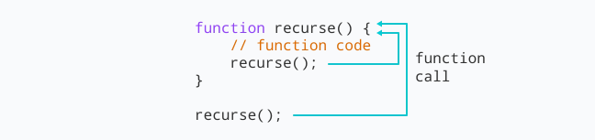
JavaScript Recursion
Recursion is a process of calling itself. A function that calls itself is called a recursive function.
The syntax for recursive function is:

Slide 8
Weekly Activity
Build a basic thumbnails gallery that allows users to view larger images when clicking on thumbnails. This task will help you practice DOM manipulation, event handling, and creating interactive user interfaces.
Write a JavaScript function that performs a simple arithmetic operation (e.g., division, multiplication) but is prone to errors such as division by zero or invalid input. Implement error handling mechanisms using try-catch blocks to handle potential errors gracefully.

